Slide 1



Columnar Storage and List-based Processing for Graph Database Management System
Pranjal Gupta, Amine Mhedhbi, Semih Salihoglu
Notes:
1/ Hello everyone, my name is Pranjal Gupta. I am a Masters’ student at the University of Waterloo. Today, I will be presenting our work on “Columnar Storage and List-based Processing for Graph Database Management Systems”.
2/ In this work, we explore the applicability of existing techniques from columnar relational database systems and also propose new solutions to adopt them in context of a native graph database systems.
3/ We base our work on GraphflowDB, an in-memory graph database system optimized for performance and scalability ... that we are developing at the University of Waterloo.

Slide 2
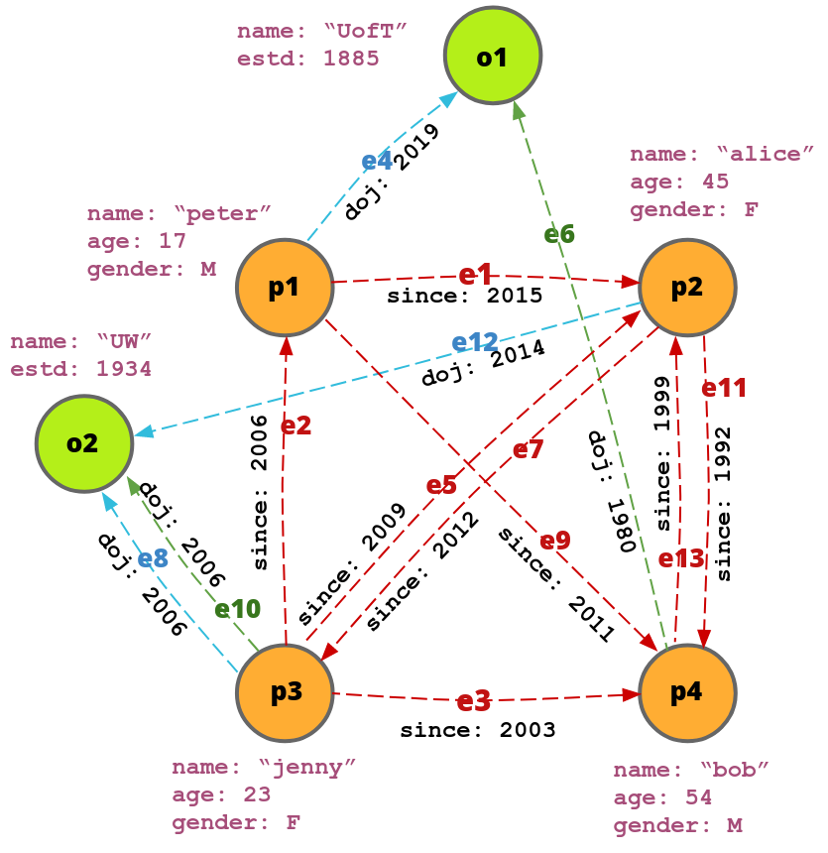
Graph Database Management Systems
Read-optimized analytical systems that can perform fast many-to-many joins.
p1
p2
p3
p4
MATCH
(a:PERSON) - [e:FOLLOWS] ➔ (b:PERSON)
WHERE
a.age > 30 & e.since > 2000
RETURN ...
e1,p2 | e9,p4 | e4,o1
e7,p3 | e11,p4
e2,p1 | e3,p4 | e5,p2 | e8,o2 | e10,o2
e13,p2
Cypher Query
Forward Adjacency Lists
Fast many-many joins are attributed to the adjacency lists data structure that indexes neighbours of all vertices in both directions, by default.
Analogous to Indexed Nested Joins in RDBMS.
p2
name | “alice” | age | 45 | gender | F
p4
name | “bob” | age | 54 | gender | M
...
o2
name | “UW” | estd | 1934
Property Graph Data Model
Row-oriented Property Store
Notes:
1/ Graph database management systems or GDBMSs are systems that are known to support read-heavy analytical workload that are known to perform fast on many-to-many joins.
2/ Similar to RDBMSs, the GDBMSs have a well defined data model which is called Property Graph Data Model. A property graph consists of entities or vertices connected by edges and have arbitrary key-value properties on them. Both vertices and edges are labelled or have a type.
3/ Typically, the edges of the graph are stored in system using a structure called Adjacency lists, which maps each vertex to its forward and backward neighbouring vertices and corresponding edges. In existing systems, adjacency lists have been realized using CSR, as in graphflowDB, or linked lists, as in Neo4J.
4/ Contrary to this, properties can be stored in many different ways. It can be stored again as a linked list (wherein each property points to the next) for each vertex or they can be stored in key-value stores or as interpreted attribute layout as illustrated here.
5/ Finally, we query the system using the cypher query language which is very similar to SQL.
6/ Fast joining capabilities …

Slide 3
Relevance of Columnar Techniques for GDBMSs
Columnar RDBMSs are optimized for read heavy workloads that requires reading large volumes of data and processing it.
Storage
Compression
Block-based processing
SELECT count(*)
FROM PERSON p
WHERE p.city = `TO`
`bob`
`jenny`
`alice`
`peter`
54
23
45
17
p4
TO
TO
VC
VC
VC=0, TO=1
p2
0011b
Scan(p.city) ➞ Filter(p.city) ➞ Aggregate
p3
Dictionary-encoded PERSON.city
p1
p2
p3
p4
p1 | VC | 0
p2 | TO | 1
p3 | VC | 0
p4 | TO | 1
p1 | VC
p2 | TO
p3 | VC
p4 | TO
p1
X
PERSON
.name
2
PERSON
.age
PERSON
.city
GDBMSs can benefit from these techniques.
BETTER CPU UTILIZATION
However !
Not directly applicable because of major differences in the nature of the graph data and access patterns of GDBMSs
Notes:
To establish relevance of Columnar Techniques for GDBMSs, note that columnar stores, too are optimized for read heavy workloads that involves reading and processing large amounts of data sequentially. They employ a number of techniques:
1/ Firstly, tables are stored column by column, not row by row. Which allows sequential read of values of an attribute from all rows with good cache locality and reduced number of I/O’s.
2/ They employ specialized compression schemes for each column, based on the type and distribution of data in that column.
3/ They process data in blocks as opposed to one tuple at a time.
4/ Consider a query to count number of persons in a city and a simple plan that scans the city of person, filters and finally aggregates. In traditional volcano-styled processing, this happens tuple at a time, starting from p1... then p2 ... p3 and finally p4. This does not exhibit good cache locality as reads are random. In comparison, block based processor reads all of person’s city column together. Then it filters and finally aggregates in a tight loop. Here sequential reads on chunk of data leads to better CPU utilization.
5/ These techniques are highly relevant in context of GDBMSs, and can make them more competent.
6/ However, as I demonstrate next, they cannot be directly applied as the 2 systems differ in their data access patterns and workloads.
7/ In this talk, I’ll demonstrate only 2 differences. Others can be found in our paper.

Slide 4
Difference in Access Patterns & Workloads (1)
Columnar RDBMSs
GDBMSs
Queries are predominantly operations over large chunks sequential column data.
Queries requires random access to large chunks of data.
Eg. Group by and Aggregates, Filter etc.
Eg. n-hop queries
SELECT p.city, count(*)
FROM Person p
GROUP BY p.city
MATCH (a:Person)-[e:Knows]->(b.Person)
WHERE a.name = ‘alice’
RETURN b.age
p4
TO
TO
VC
VC
p4
54
23
45
17
p2
TO | 2
VC | 2
p2
Scan(a) ➞ Filter(a.name) ➞ Join(b) ➞ Return b.age
p3
p3
p1
p3 (alice)
e5,p2 | e3,p4 | e2,p1
p1
PERSON
.city
PERSON
.age
Cannot use vanilla columnar compression techniques directly.
Because these techniques require decompressing an entire block sequentially
Notes:
1/ The first difference is … that … the 2 systems differ in data access.
2/ Columnar systems are optimized for queries performing sequential access on large chunks of data. A textbook query can be one heavy on filters, group bys and aggregates … like the one shown here which counts number of persons in each cities. For this, the system simply reads the city column sequentially, and counts 2 group of values in it.
3/ In contrast, a typical query in GDBMSs is like finding friends of friends of a person and operating over their properties. Such queries too access large amounts of data, however, they do so randomly.
4/ Consider 1-hop query, which reads the age of Alice’s friends. Our plan scans all persons and filters Alice (which is node p3), then joins it to neighbour node and reads age property of that node. Suppose we have filtered `Alice`. then the join operator reads the first element from `Alice’s` fwd adj list then read the age property. This happens for other values too in the adj list. Hence, as we see here, reading properties are random.
5/ One implication of this difference … is that the compression in Columnar stores need not support decompressing random elements from a compressed block since reading is sequential. Whereas graph systems needs random access for which they should be able to do random reads in compressed block efficiently, without decompress the block. Hence, columnar compression techniques cannot be directly adopted.

Slide 5

Difference in Access Patterns & Workloads (2)
Columnar RDBMSs
GDBMSs
Primary Key - Foreign Key joins are prevalent.
Many-to-many joins are prevalent.
Intermediate join results do not grow.
Intermediate results grow with value replication.
k11
alice | k1 | k11
alice | k1 | k12
alice | k1 | k13
... | ... | ...
alice | k3 | k32
alice | k3 | k33
k1
k12
PK
FK
k13
... | 2
... | 1
k21
1 | ...
2 | ...
... | 1 | ...
... | 2 | ...
k2
k22
alice
k23
Table A
Table B
k3
k31
k32
k33
Intermediate tuples
Vanilla Block-based Processing do not avoid value replication and hence, can be inefficient.
Notes:
1/ The 2 systems also differ in the nature of joins they perform.
2/ The joins in columnar RDBMs are dominantly primary key - foreign key joins which do not grow. That is, there is no explosion in the number of intermediate tuples produced, and nearly no data replication.
3/ However, in graph systems, joins are typically many-to-many. As a result, joins grows rapidly, that is, the number of intermediate tuples explodes with lots of replication, that increases with number of joins in the query.
4/ Same is shown in the illustration where where we find Alice friends of friends The intermediate tuple grown from 1 tuple (this is alice) to 9, with `Alice` repeated in each tuple.
5/ As I demonstrate later in the talk, block based processors employed by columnar stores are not optimized for growing joins because of data replication. So, direct adaptation of block-based processing can give sub optimal results.
6/ I’ll limit the differences here and next move on the contributions of our paper.

Slide 6
Research Contributions
Columnar RDBMSs
GDBMSs
STORAGE
Vanilla columns for vertex properties.
DIRECT ADAPTATION
Vanilla append-only Columns
NOVEL
Single-index edge property pages.
COMPRESSION
Dictionary Encoding
DIRECT ADAPTATION
NULL Compression using bit-strings [Abadi, CIDR 2007]
NOVEL
NULL Compressing using Jacobson’s bit vector index
Compression using new edge ID scheme
NOVEL
QUERY PROCESSING
Block-based processing
NOVEL
List-based processing
Notes:
1/ columnar techniques cannot always be directly adapted, and hence require redesigning to suit our requirements. Our work study these requirements and proposes new designs across storage, compression and query processing.
2/ we identify techniques that are directly applicable, for example, vanilla columns for vertex properties and dictionary encoding compression.
3/ Where direct application is not feasible, we design new techniques like the single-indexed edge property pages, a new edge ID scheme that can be highly compressed in adjlists, a NULL compression scheme that allows random reads from compressed data and a list-based processor.
4/ For the scope of this talk, I would only discuss List based processor. Other techniques can be found in our paper.

Slide 7
Single-indexed Edge Property Pages
Notes:
1/ To motivate our case for a new query processor, we first revisit the design of the block-based processor.

Slide 8
Observation
Edge and Vertex properties are read in the same order as edges in the adjacency lists.
MATCH (a:PERSON) - [e:FOLLOWS] ➔ (b:PERSON)
WHERE a = p3
RETURN e.since, b.age
e1 | 2015
e11 | 1992
e3 | 2003
e7 | 2012
e5 | 2009
e9 | 2011
e2 | 2006
e13 | 1999
[Scan a ] ➔ [Filter a = p3] ➔ [Join a with b] ➔ RETURN e.since, b.age
p3
p4 | 54
p2 | 23
p3 | 45
p1 | 17
e5,p2 | e3,p4 | e2,p1
REQUIRED PROPERTY
Edge properties should be stored & read sequentially in the order edges are stored in the adjacency lists.
KNOWS
since
PERSON
age
However !
We cannot do the same for vertex properties.

Slide 9
Columnar Storage
Simple append-only Columns:
p4
54
23
45
17
Can be used to store vertex properties.
p2
Direct access to the property value using offset in column.
p3
Suboptimal with edge properties, as does not satisfy our required of sequential reads.
p1
NON-SEQ READS
PERSON
age
Doubly-indexed Edge Property Lists:
Inspired by Adjacency Lists.
p1
p1
2015 | 2011
2006
p2
p2
2012 | 1992
2015 | 2009 | 1999
SEQ READS
p3
p3
2012
2006 | 2003 | 2009
2x DATA DUPLICATION
p4
2003 | 2011 | 1992
p4
1999
KNOWS
since
FWD
BWD
Notes:
We can directly use simple columnar structures. New Properties are added at the end, properties can be accessed using the offset in column.
This is suitable for vertex properties because we do not care about sequential reads, but not for edge properties.
For the edge properties we can use a data structure similar to adjacency lists, wherein each property of edge is indexed in a forward and backward direction. Based on what direction of adjlist the edges are read, same directional property list of the required edge property can be read. However there is 2x data replication which is undesired as there are far many edges than vertices.

Slide 10
Single-indexed Edge Property Lists.
Keep property lists in only one direction.
Provide for random access of the property when edges are read from adjacency list of opposite direction.
p1
2015 | 2011
p2
2012 | 1992
p3
2006 | 2003 | 2009
SEQ READS IN ONE DIRECTION
p4
1999
For an edge, requires an offset in the appropriate property list to access its property:
FWD
New Edge ID scheme:
EDGE LABEL
SRC/DEST VERTEX INFO
LIST-LEVEL OFFSET
src vertex if the edge properties are indexed in property list by fwd adjacency list
Offset in the property list
Optimized for updates: Single-indexed Edge Property Pages
Notes:
We can directly use simple columnar structures. New Properties are added at the end, properties can be accessed using the offset in column.
This is suitable for vertex properties because we do not care about sequential reads, but not for edge properties.
For the edge properties we can use a data structure similar to adjacency lists, wherein each property of edge is indexed in a forward and backward direction. Based on what direction of adjlist the edges are read, same directional property list of the required edge property can be read. However there is 2x data replication which is undesired as there are far many edges than vertices.

Slide 11
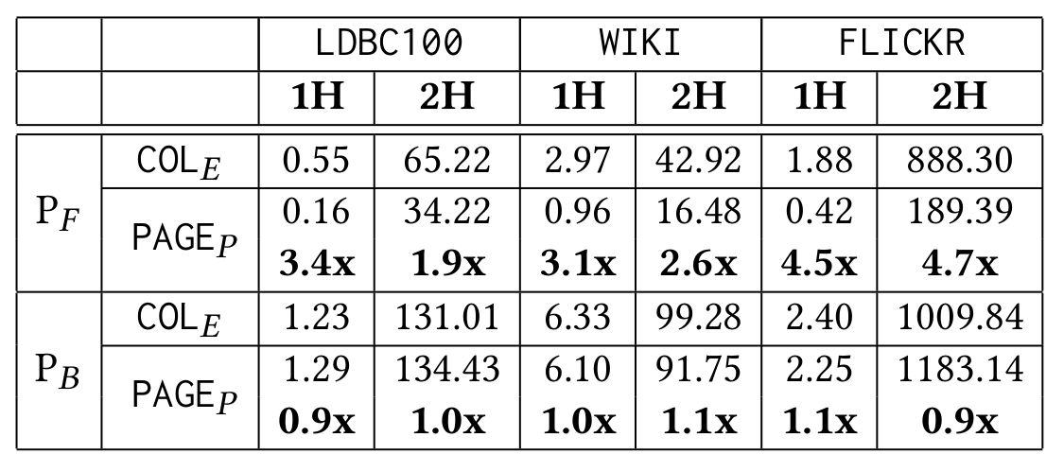
Evaluation
Datasets: LDBC100, FLICKR, WIKI
Queries: n-Hop with either Filter or Aggregation on the last Join
Configurations: |COLE - Simple append-only columns for storing edge properties
,,,PAGEE - Single-directional edge property pages for edge properties
Notes:
We can directly use simple columnar structures. New Properties are added at the end, properties can be accessed using the offset in column.
This is suitable for vertex properties because we do not care about sequential reads, but not for edge properties.
For the edge properties we can use a data structure similar to adjacency lists, wherein each property of edge is indexed in a forward and backward direction. Based on what direction of adjlist the edges are read, same directional property list of the required edge property can be read. However there is 2x data replication which is undesired as there are far many edges than vertices.

Slide 12
NULL Compression
using Jacobsons’ bit vector index
Notes:
1/ To motivate our case for a new query processor, we first revisit the design of the block-based processor.

Slide 13
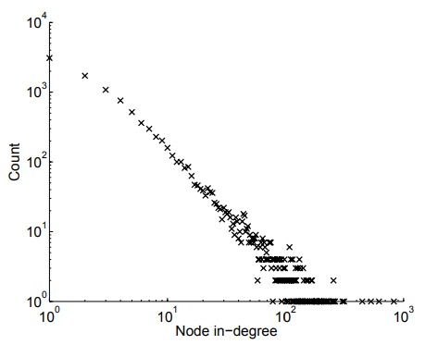
Observation
Properties on edges and vertices can be very sparse.
The degree of most vertices are super small. (by power law)
Reading vertex property (in FILTER) and adjacency list (in JOIN) is like reading small chunk of data followed by random access.
Block 1
Block 2
….
Block n
NULLs
REQUIRED PROPERTY
If compression is used, decompressing arbitrary data elements in a compressed block should happen in constant time.

Slide 14
NULL Compression
Existing solution to compress columns using bit-strings. [Abadi, CIDR 2007]
Suitable only for sequential access of column. Do not support reading from arbitrary offsets of columns.
 |  | 7 |  | 6 | 3 | 2 |  |  | 8 | 11 |  | 2 | 3
...
0
1
2
3
4
5
6
7
8
9
10
11
12
13
14
15
Uncompressed block
notNull values
7 | 6 | 3 | 2 | 8 | 11 | 2 | 3 | 5
bitStrings
0011011001110100_{b}
rank(9) = 4

Slide 15
Using Jacobson's bit vector index
Solution: Calculate the rank of an offset in constant time.
Use Jacobson’s rank index. [Jacobson, FOCS 1989]
 |  | 7 |  | 6 | 3 | 2 |  |  | 8 | 11 |  | 2 | 3
...
0
1
2
3
4
5
6
7
8
9
10
11
12
13
14
15
Uncompressed block
0
1
2
3
notNull values
7 | 6 | 3 | 2 | 8 | 11 | 2 | 3 | 5
... | ... | ... | ...
0 | 1 | 1 | 2
0 | 0 | 1 | 2
0 | 1 | 2 | 3
... | ... | ... | ...
0101_{b}
bitStrings
0100_{b}
0111_{b}
0110_{b}
0011_{b}
0110_{b}
0111_{b}
prefix sums
0
1
4
6
Bit position to index Map
chunkIdx = 2
position of element in chunk (i) = 1
position in notNull values array = 4 + 0 = 4

Slide 16
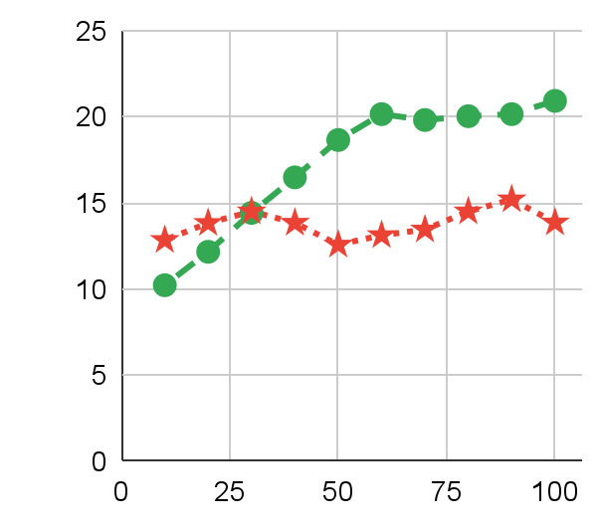
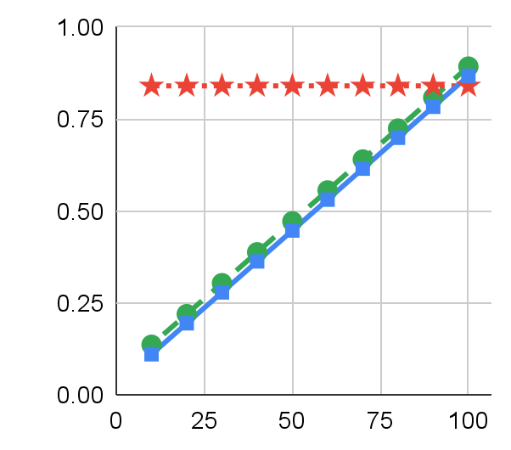
Evaluation
Datasets: 1 vertex property column with 220M entries) with different %s of NULL values
Queries: 1-Hop with Property access
Configurations:
Uncompressed
J-NULL
Vanilla-NULL
Size (in GB)
Query runtime (in sec)
Percentage of non-NULL values
Percentage of non-NULL values

Slide 17
List-based Processing
Notes:
1/ To motivate our case for a new query processor, we first revisit the design of the block-based processor.

Slide 18
Volcano-styled Processing
MATCH (a:PERSON)-[e:FOLLOWS]➔(b:PERSON)
WHERE a = p3
RETURN e.since, b.age
e1 | 2015
e11 | 1992
e3 | 2003
e7 | 2012
e5 | 2009
e9 | 2011
e2 | 2006
e13 | 1999
[Scan a ] ➔ [Filter a = p3] ➔ [Join a with b] ➔ RETURN e.since, b.age
p3
e5,p2 | e3,p4 | e2,p1
p4 | 54
p2 | 23
p3 | 45
p1 | 17
p3
e5
e3
e2
p2
p4
p1
23
54
17
2009
2003
2006
a
e
b
b.age
e.since
Bad Cache Locality !
Do not harness the fact that adjacency lists and edge properties are stored sequentially in memory.
KNOWS
since
PERSON
age
Notes:
1/ Typically, the graph systems employ volcano-based processing that evaluates the query tuple at a time. Examples being, neo4j and janus graph.
2/ Given a simple 1 hop query which returns a properties of edge and the neighbour vertex, Volcano-based processor produces one result, then goes on to produce another result, and so on.The query execution pipeline runs iteratively for as many times as the number of resultant tuples.
2/ For this particular query plan, we begin by scanning each person’s vertex iteratively and keeping it in the intermediate tuple. only p3 passes the filter. Then the join operator accesses p3’s fwd adj list and reads its first element by copying it to the intermediate tuple followed by reading values of b.age and e.since from the property storage to produce the final tuple. Now the join operator reads another element from p3’s fwd adj list and again relevant properties are read. This goes iteratively.
3/ Here, as we can see that each operator puts one value into the intermediate tupe at a time (which is a random access), even though the adjlists are stored sequentially. Hence, we get bad cache locality here.

Slide 19
Shortcomings of Block-based Processing
MATCH (a:PERSON) - [r1:FOLLOWS] ➔ (b:PERSON)
(b:PERSON) - [r2:FOLLOWS] ➔ (c:PERSON)
WHERE a.age > 20
RETURN ...
[Scan a ] ➔ [Filter a.age > 20] ➔ [Join a with b] ➔ [Join b with c] ➔ RETURN ...
... | ... | ... | ... | ...
p2 | 23 | 1 | e7 | p3
p2 | 23 | 1 | e11 | p4
p3 | 45 | 1 | e5 | p2
p3 | 45 | 1 | e3 | p4
p3 | 45 | 1 | e2 | p1
... | ... | ... | ... | ...
p2
e7,p3 | e11,p4
p3
e5,p2 | e3,p4 | e2,p1
p1
p2
p3
p4
p1 | 17 | 0
p2 | 23 | 1
p3 | 45 | 1
p4 | 54 | 1
p4
➔
➔
e13,p2
a
a
age
filtermask
a
age
mask
r1
b
Notes:
1/ Traditional block based processors fall short of being performant on many-to-many joins that is the USP of graph data.
2/ Consider a 2 hop query on person nodes with a filter on the age property of first node. I use simple left deep query plan that scans a person, filters by age and joins from a to b and b to c.
4/ The block-based processor start with a single vector with all person node IDs. It then reads the age column and perform filter sequentially. The result of the filter is stored in a bit mask vector. It will then Join all nodes in vector `a` to the elements of their fwd adjlist by copying them in vectors `r1` and `b`. Here, only part of the intermediate data chunk is shown but as can be seen, p2 is replicated twice and p3 thrice, that are the sizes of their fwd adj lists respectively.
5/ Similar replication happens on the next join too, as can be seen in vectors `a`, `r1` and `b`.
6/ Hence, there is high replication of data in intermediate data chunk. Reason being that the intermediate data chunk represents the set of flat tuples in a single group of vectors. Each row in the data chunk is a resultant tuple.
7/ Momentarily as I show, this can be fixed by factorized representation.

Slide 20
Shortcomings of Block-based Processing
MATCH (a:PERSON) - [r1:FOLLOWS] ➔ (b:PERSON)
(b:PERSON) - [r2:FOLLOWS] ➔ (c:PERSON)
WHERE a.age > 20
RETURN ...
[Scan a ] ➔ [Filter a.age > 20] ➔ [Join a with b] ➔ [Join b with c] ➔ RETURN ...
... | ... | ... | ... | ...
p2 | 23 | 1 | e7 | p3
p2 | 23 | 1 | e11 | p4
p3 | 45 | 1 | e5 | p2
p3 | 45 | 1 | e3 | p4
p3 | 45 | 1 | e2 | p1
... | ... | ... | ... | ...
... | ... | ... | ... | ... | ... | ...
p3 | 45 | 1 | e5 | p2 | e7 | p3
p3 | 45 | 1 | e5 | p2 | e11 | p4
p3 | 45 | 1 | e3 | p4 | e13 | p2
p3 | 45 | 1 | e2 | p1 | e1 | p2
p3 | 45 | 1 | e2 | p1 | e9 | p4
... | ... | ... | ... | ... | ... | ...
p1
p2
p3
p4
p1 | 17 | 0
p2 | 23 | 1
p3 | 45 | 1
p4 | 54 | 1
➔
➔
➔
a
a
age
filtermask
a
age
mask
r1
b
a
age
mask
r1
b
r2
c
Notes:
1/ Traditional block based processors fall short of being performant on many-to-many joins that is the USP of graph data.
2/ Consider a 2 hop query on person nodes with a filter on the age property of first node. I use simple left deep query plan that scans a person, filters by age and joins from a to b and b to c.
4/ The block-based processor start with a single vector with all person node IDs. It then reads the age column and perform filter sequentially. The result of the filter is stored in a bit mask vector. It will then Join all nodes in vector `a` to the elements of their fwd adjlist by copying them in vectors `r1` and `b`. Here, only part of the intermediate data chunk is shown but as can be seen, p2 is replicated twice and p3 thrice, that are the sizes of their fwd adj lists respectively.
5/ Similar replication happens on the next join too, as can be seen in vectors `a`, `r1` and `b`.
6/ Hence, there is high replication of data in intermediate data chunk. Reason being that the intermediate data chunk represents the set of flat tuples in a single group of vectors. Each row in the data chunk is a resultant tuple.
7/ Momentarily as I show, this can be fixed by factorized representation.

Slide 21
Shortcomings of Block-based Processing
MATCH (a:PERSON) - [r1:FOLLOWS] ➔ (b:PERSON)
(b:PERSON) - [r2:FOLLOWS] ➔ (c:PERSON)
WHERE a.age > 20
RETURN ...
[Scan a ] ➔ [Filter a.age > 20] ➔ [Join a with b] ➔ [Join b with c] ➔ RETURN ...
... | ... | ... | ... | ...
p2 | 23 | 1 | e7 | p3
p2 | 23 | 1 | e11 | p4
p3 | 45 | 1 | e5 | p2
p3 | 45 | 1 | e3 | p4
p3 | 45 | 1 | e2 | p1
... | ... | ... | ... | ...
Shortcoming #1
High amount of data replication in intermediate data chunks.
p1
p2
p3
p4
p1 | 17 | 0
p2 | 23 | 1
p3 | 45 | 1
p4 | 54 | 1
Because intermediate data chunk represents a set of flat values using 1 group of vectors.
➔
➔
a
a
age
filtermask
a
age
mask
r1
b
Notes:
1/ Traditional block based processors fall short of being performant on many-to-many joins that is the USP of graph data.
2/ Consider a 2 hop query on person nodes with a filter on the age property of first node. I use simple left deep query plan that scans a person, filters by age and joins from a to b and b to c.
4/ The block-based processor start with a single vector with all person node IDs. It then reads the age column and perform filter sequentially. The result of the filter is stored in a bit mask vector. It will then Join all nodes in vector `a` to the elements of their fwd adjlist by copying them in vectors `r1` and `b`. Here, only part of the intermediate data chunk is shown but as can be seen, p2 is replicated twice and p3 thrice, that are the sizes of their fwd adj lists respectively.
5/ Similar replication happens on the next join too, as can be seen in vectors `a`, `r1` and `b`.
6/ Hence, there is high replication of data in intermediate data chunk. Reason being that the intermediate data chunk represents the set of flat tuples in a single group of vectors. Each row in the data chunk is a resultant tuple.
7/ Momentarily as I show, this can be fixed by factorized representation.

Slide 22
Shortcomings of Block-based Processing
MATCH (a:PERSON) - [r1:FOLLOWS] ➔ (b:PERSON)
(b:PERSON) - [r2:FOLLOWS] ➔ (c:PERSON)
WHERE a.age > 20
RETURN ...
[Scan a ] ➔ [Filter a.age > 20] ➔ [Join a with b] ➔ [Join b with c] ➔ RETURN ...
... | ... | ... | ... | ...
p2 | 23 | 1 | e7 | p3
p2 | 23 | 1 | e11 | p4
p3 | 45 | 1 | e5 | p2
p3 | 45 | 1 | e3 | p4
p3 | 45 | 1 | e2 | p1
... | ... | ... | ... | ...
p2
e7,p3 | e11,p4
p3
e5,p2 | e3,p4 | e2,p1
p1
p2
p3
p4
p1 | 17 | 0
p2 | 23 | 1
p3 | 45 | 1
p4 | 54 | 1
p4
➔
➔
e13,p2
a
a
age
filtermask
a
age
mask
r1
b
Notes:
1/ Also, if we go back a bit, notice that the contents of ‘r1’ and ‘b’ are exact replicas of the adj lists p2 and p3, that is kept in memory for an in-memory gdbms. Hence, We can prevent the materialization of adjlists in our intermediate data chunks
2/ The second shortcoming ... is that the block based processor copies exact replica of adjlists in intermediate data chunk.

Slide 23
Shortcomings of Block-based Processing
MATCH (a:PERSON) - [r1:FOLLOWS] ➔ (b:PERSON)
(b:PERSON) - [r2:FOLLOWS] ➔ (c:PERSON)
WHERE a.age > 20
RETURN ...
[Scan a ] ➔ [Filter a.age > 20] ➔ [Join a with b] ➔ [Join b with c] ➔ RETURN ...
... | ... | ... | ... | ...
p2 | 23 | 1 | e7 | p3
p2 | 23 | 1 | e11 | p4
p3 | 45 | 1 | e5 | p2
p3 | 45 | 1 | e3 | p4
p3 | 45 | 1 | e2 | p1
... | ... | ... | ... | ...
p2
Shortcoming #2
e7,p3 | e11,p4
p3
e5,p2 | e3,p4 | e2,p1
Copies exact replicas of adjacency lists to intermediate data chunk.
p1
p2
p3
p4
p1 | 17 | 0
p2 | 23 | 1
p3 | 45 | 1
p4 | 54 | 1
p4
➔
➔
e13,p2
a
a
age
filtermask
a
age
mask
r1
b
Notes:
1/ Also, if we go back a bit, notice that the contents of ‘r1’ and ‘b’ are exact replicas of the adj lists p2 and p3, that is kept in memory for an in-memory gdbms. Hence, We can prevent the materialization of adjlists in our intermediate data chunks
2/ The second shortcoming ... is that the block based processor copies exact replica of adjlists in intermediate data chunk.

Slide 24
List-based Processing
Factorized representation of intermediate data [Olteanu, SIGMOD Rec. 2016].
... | ... | ... | ...
p2 | 23 | e7 | p3
p2 | 23 | e11 | p4
p3 | 45 | e5 | p2
p3 | 45 | e3 | p4
p3 | 45 | e2 | p1
... | ... | ... | ...
{p2, 23} | X | { (e7,p3), (e11,p4) }
U
{p3, 45} | X | { (e5,p2), (e3,p4), (e2,p1) }
a, age
b
r1
a
age
r1
b
List Groups
Instead of 1 group of vectors, multiple groups that either be a single tuple or list of tuples.
Instead of fixed-size vectors, variable-size vectors that depend on adjacency list sizes.
Avoid materializing adjacency lists in list groups
Notes:
1/ We address the shortcomings of block-based processor with our list-based processor, that is based on two key concepts:
2/ First, we use Factorized representation that given by Olteanu in 2016, to succinctly represent joins as a union of products of independent components. Using this representation, the intermediate data chuck after 1 join of query on last slide can be given as the union of product of 2 components ... a singleton lists p2 and p3 and fwd adj lists of p2 and p3 respectively.
3/ Second, Our implementation uses Lists Groups. In our implementation, a single intermediate data chunk is made up of number of list groups which has 3 properties: 1) A list group can either be a single value or list of values, 2) size of list group is not fixed and takes the size of adj list that it holds. and 2) list groups do not materialize the adj lists and just hold pointer to the relevant adj list in memory.

Slide 25
List-based Processing
MATCH (a:PERSON) - [r1:FOLLOWS] ➔ (b:PERSON)
(b:PERSON) - [r2:FOLLOWS] ➔ (c:PERSON)
WHERE a.age > 20
RETURN ...
[Scan a ] ➔ [Filter a.age > 20] ➔ [Join a with b] ➔ [Join b with c] ➔ RETURN ....
LG1
p1
p2
p3
p4
a
currIdx = -1
currIdx = -1
Notes:
1/ We now run a simulation demonstrating our List based processing.
2/ Consider the same 2 hop query and the query plan as before.
3/ The scan operator creates a new list Group ( called LG1) with a vector `a` containing person nodes.
4/ Each list group has a currIdx field that is either -1 which means all tuples in the list group are part of the intermediate data chunk or it can take a positive value, meaning the list group is flattened and represents a single tuples. Currently, LG1 is unflattened.
5/ Next, The filter operator operates on the unflattened LG1 and reads the age property for nodes in `a` and evaluates the age in mask vector.
4/ We then move to join which does 2 things, 1) it flattens LG1 by setting currIdx to 1 (since 0th location is filtered out). Now LG1 is interpreted as a single tuple. And 2) join creates a new list group called LG2 and reads the adj list of p2 into r1 and b. overall , Flattening of LG1 prevents the need to copy tuple in LG1 with each tuple in LG2. Also, we avoid materialization in r1 and b by instead having pointers to fwd adj list of p2.
5/ The second joins, follows the same operations. It flattens lg2 by setting currIdx = 0, and creates LG3 that points to the adj list of p3 in memory.
6/ The factorized representation at this point is a product of p2, fwd adjlist of p2 and fwd adjlist of p3 Going forward, the 2nd join then increments currIdx of LG2 and reads adj list of p4 to LG3.
7/ We experiment list-based processing on LDBC, which is a popular benchmark for evaluating Graph systems, along with datasets from other domains as well. To sum up, we get speedup of minimum 3x and upto 19x on our queries. Complete evaluation can be found in the paper

Slide 26
List-based Processing
MATCH (a:PERSON) - [r1:FOLLOWS] ➔ (b:PERSON)
(b:PERSON) - [r2:FOLLOWS] ➔ (c:PERSON)
WHERE a.age > 20
RETURN ...
[Scan a ] ➔ [Filter a.age > 20] ➔ [Join a with b] ➔ [Join b with c] ➔ RETURN ....
LG1
p1 | 17 | 0
p2 | 23 | 1
p3 | 45 | 1
p4 | 54 | 1
a
age mask
currIdx = -1
Notes:
1/ We now run a simulation demonstrating our List based processing.
2/ Consider the same 2 hop query and the query plan as before.
3/ The scan operator creates a new list Group ( called LG1) with a vector `a` containing person nodes.
4/ Each list group has a currIdx field that is either -1 which means all tuples in the list group are part of the intermediate data chunk or it can take a positive value, meaning the list group is flattened and represents a single tuples. Currently, LG1 is unflattened.
5/ Next, The filter operator operates on the unflattened LG1 and reads the age property for nodes in `a` and evaluates the age in mask vector.
4/ We then move to join which does 2 things, 1) it flattens LG1 by setting currIdx to 1 (since 0th location is filtered out). Now LG1 is interpreted as a single tuple. And 2) join creates a new list group called LG2 and reads the adj list of p2 into r1 and b. overall , Flattening of LG1 prevents the need to copy tuple in LG1 with each tuple in LG2. Also, we avoid materialization in r1 and b by instead having pointers to fwd adj list of p2.
5/ The second joins, follows the same operations. It flattens lg2 by setting currIdx = 0, and creates LG3 that points to the adj list of p3 in memory.
6/ The factorized representation at this point is a product of p2, fwd adjlist of p2 and fwd adjlist of p3 Going forward, the 2nd join then increments currIdx of LG2 and reads adj list of p4 to LG3.
7/ We experiment list-based processing on LDBC, which is a popular benchmark for evaluating Graph systems, along with datasets from other domains as well. To sum up, we get speedup of minimum 3x and upto 19x on our queries. Complete evaluation can be found in the paper

Slide 27
List-based Processing
MATCH (a:PERSON) - [r1:FOLLOWS] ➔ (b:PERSON)
(b:PERSON) - [r2:FOLLOWS] ➔ (c:PERSON)
WHERE a.age > 20
RETURN ...
[Scan a ] ➔ [Filter a.age > 20] ➔ [Join a with b] ➔ [Join b with c] ➔ RETURN ....
p2
LG1
LG2
e7,p3 | e11,p4
p1 | 17 | 0
p2 | 23 | 1
p3 | 45 | 1
p4 | 54 | 1
e7 | p3
e11 | p4
r1
b
currIdx = -1
Performance speedups upto 19x
on LDBC100
a
age mask
currIdx = 1
Notes:
1/ We now run a simulation demonstrating our List based processing.
2/ Consider the same 2 hop query and the query plan as before.
3/ The scan operator creates a new list Group ( called LG1) with a vector `a` containing person nodes.
4/ Each list group has a currIdx field that is either -1 which means all tuples in the list group are part of the intermediate data chunk or it can take a positive value, meaning the list group is flattened and represents a single tuples. Currently, LG1 is unflattened.
5/ Next, The filter operator operates on the unflattened LG1 and reads the age property for nodes in `a` and evaluates the age in mask vector.
4/ We then move to join which does 2 things, 1) it flattens LG1 by setting currIdx to 1 (since 0th location is filtered out). Now LG1 is interpreted as a single tuple. And 2) join creates a new list group called LG2 and reads the adj list of p2 into r1 and b. overall , Flattening of LG1 prevents the need to copy tuple in LG1 with each tuple in LG2. Also, we avoid materialization in r1 and b by instead having pointers to fwd adj list of p2.
5/ The second joins, follows the same operations. It flattens lg2 by setting currIdx = 0, and creates LG3 that points to the adj list of p3 in memory.
6/ The factorized representation at this point is a product of p2, fwd adjlist of p2 and fwd adjlist of p3 Going forward, the 2nd join then increments currIdx of LG2 and reads adj list of p4 to LG3.
7/ We experiment list-based processing on LDBC, which is a popular benchmark for evaluating Graph systems, along with datasets from other domains as well. To sum up, we get speedup of minimum 3x and upto 19x on our queries. Complete evaluation can be found in the paper

Slide 28
List-based Processing
MATCH (a:PERSON) - [r1:FOLLOWS] ➔ (b:PERSON)
(b:PERSON) - [r2:FOLLOWS] ➔ (c:PERSON)
WHERE a.age > 20
RETURN ...
[Scan a ] ➔ [Filter a.age > 20] ➔ [Join a with b] ➔ [Join b with c] ➔ RETURN ....
p2
LG1
LG2
LG3
e7,p3 | e11,p4
p1 | 17 | 0
p2 | 23 | 1
p3 | 45 | 1
p4 | 54 | 1
e7 | p3
e11 | p4
p3
e5 | p2
e3 | p4
e2 | p1
e5,p2 | e3,p4 | e2,p1
r1
b
currIdx = 0
r2
c
a
age mask
currIdx = -1
currIdx = 1
Notes:
1/ We now run a simulation demonstrating our List based processing.
2/ Consider the same 2 hop query and the query plan as before.
3/ The scan operator creates a new list Group ( called LG1) with a vector `a` containing person nodes.
4/ Each list group has a currIdx field that is either -1 which means all tuples in the list group are part of the intermediate data chunk or it can take a positive value, meaning the list group is flattened and represents a single tuples. Currently, LG1 is unflattened.
5/ Next, The filter operator operates on the unflattened LG1 and reads the age property for nodes in `a` and evaluates the age in mask vector.
4/ We then move to join which does 2 things, 1) it flattens LG1 by setting currIdx to 1 (since 0th location is filtered out). Now LG1 is interpreted as a single tuple. And 2) join creates a new list group called LG2 and reads the adj list of p2 into r1 and b. overall , Flattening of LG1 prevents the need to copy tuple in LG1 with each tuple in LG2. Also, we avoid materialization in r1 and b by instead having pointers to fwd adj list of p2.
5/ The second joins, follows the same operations. It flattens lg2 by setting currIdx = 0, and creates LG3 that points to the adj list of p3 in memory.
6/ The factorized representation at this point is a product of p2, fwd adjlist of p2 and fwd adjlist of p3 Going forward, the 2nd join then increments currIdx of LG2 and reads adj list of p4 to LG3.
7/ We experiment list-based processing on LDBC, which is a popular benchmark for evaluating Graph systems, along with datasets from other domains as well. To sum up, we get speedup of minimum 3x and upto 19x on our queries. Complete evaluation can be found in the paper

Slide 29
List-based Processing
MATCH (a:PERSON) - [r1:FOLLOWS] ➔ (b:PERSON)
(b:PERSON) - [r2:FOLLOWS] ➔ (c:PERSON)
WHERE a.age > 20
RETURN ...
[Scan a ] ➔ [Filter a.age > 20] ➔ [Join a with b] ➔ [Join b with c] ➔ RETURN ....
p2
LG1
LG2
LG3
e7,p3 | e11,p4
p1 | 17 | 0
p2 | 23 | 1
p3 | 45 | 1
p4 | 54 | 1
e7 | p3
e11 | p4
p3
e13 | p2
e5,p2 | e3,p4 | e2,p1
r2
c
p4
r1
b
currIdx = -1
e13,p2
currIdx = 1
Performance speedups upto 19x
on LDBC100
a
age mask
currIdx = 1
Notes:
1/ We now run a simulation demonstrating our List based processing.
2/ Consider the same 2 hop query and the query plan as before.
3/ The scan operator creates a new list Group ( called LG1) with a vector `a` containing person nodes.
4/ Each list group has a currIdx field that is either -1 which means all tuples in the list group are part of the intermediate data chunk or it can take a positive value, meaning the list group is flattened and represents a single tuples. Currently, LG1 is unflattened.
5/ Next, The filter operator operates on the unflattened LG1 and reads the age property for nodes in `a` and evaluates the age in mask vector.
4/ We then move to join which does 2 things, 1) it flattens LG1 by setting currIdx to 1 (since 0th location is filtered out). Now LG1 is interpreted as a single tuple. And 2) join creates a new list group called LG2 and reads the adj list of p2 into r1 and b. overall , Flattening of LG1 prevents the need to copy tuple in LG1 with each tuple in LG2. Also, we avoid materialization in r1 and b by instead having pointers to fwd adj list of p2.
5/ The second joins, follows the same operations. It flattens lg2 by setting currIdx = 0, and creates LG3 that points to the adj list of p3 in memory.
6/ The factorized representation at this point is a product of p2, fwd adjlist of p2 and fwd adjlist of p3 Going forward, the 2nd join then increments currIdx of LG2 and reads adj list of p4 to LG3.
7/ We experiment list-based processing on LDBC, which is a popular benchmark for evaluating Graph systems, along with datasets from other domains as well. To sum up, we get speedup of minimum 3x and upto 19x on our queries. Complete evaluation can be found in the paper

Slide 30
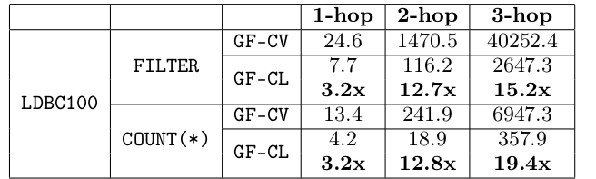
Evaluation
Queries: n-Hop with either Filter or Aggregation on the last Join
Configurations: |GF-CV - Column-oriented, Volcano-styled processing
,,,GF-CL - Column-oriented, List-based processing
Datasets: LDBC100, FLICKR, WIKI
Notes:
1/ Finally some numbers.
2/ We evaluate list based processor on n-hops for n = 1, 2, 3 with filters and aggregates on 2 different configurations GF-CV: is the version of graphflowDB that uses volcano-styled processing whereas GF-CL: uses list-based processing.
3/ We run our queries on LDBC dataset of scale factor 100, FLIKCR dataset and WIKI.
3/ Here, we show the number for only LDBC100. We see the performance gains in range of 3x to 19x.

Slide 31
References
Column Stores for Wide and Sparse Data.
Daniel J. Abadi. CIDR 2007
Column-Stores vs. Row-Stores: How Different Are They Really?
Daniel J. Abadi, Samuel Madden, and Nabil Hachem. SIGMOD 2008
Factorized Databases.
Dan Olteanu and Maximilian Schleich. SIGMOD Record 2016.
Visit us at: http://graphflow.io
C-store: A Column-Oriented DBMS.
Mike Stonebraker, et. al.. Making Databases Work 2019
MonetDB: Two Decades of Research in Column-oriented Database Architectures.
Stratos Idreos et. al.. IEEE Data Engineering Bulletin 2012
Space-efficient Static Trees and Graphs.
Guy Jacobson. FOCS 1989
End.
Vectorwise: Beyond Column Stores.
Marcin Zukowski and Peter A. Boncz. IEEE Data Engineering Bulletin 2012
Volcano - An Extensible and Parallel Query Evaluation System
Goetz Graefe. IEEE Transactions on Knowledge and Data Engineering, TKDE 1994
Notes:
1/ So to end the talk, I would to like to point all towards our project page, graphflow.io, which contains our past research and talks.
2/ Also, we have the reference on which we base our work on.
3/ thank you.

Slide 32
Questions?

Slide 33
Extras

Slide 34
Graph Database Management System (GDBMS)
GDBMSs are systems are read-optimized systems that are known to support read heavy workloads that predominantly contains large number of many-to-many joins.
p1
e1,p2 | e9,p4 | e4,o1
p2
e7,p3 | e11,p4
p3
e2,p1 | e3,p4 | e5,p2 | e8,o2 | e10,o2
p4
e13,p2
Adjacency Lists
Applications like fraud detection, recommendation systems, social networks.
Graph Data
Notes:
1/ graph database management systems (or GDBMS) are read optimized systems that are know to support read heavy workloads containing large number of many-to many joins.
2/ These system are tuned to perform fast joins on many-to-many relationships that is a unique characteristics of the graph data.
3/ They are able to do so by making use of adjacency lists that maps a vertex to its set of neighbour vertices and corresponding edges.
4/ Typical applications of GDBMSs include fraud detection, recommendation systems and social network analysis,

Slide 35
Graph Databases 101: Model
name: “UofT”
estd: 1885
o1
Vertices
name: “alice”
age: 45
gender: F
e4
doj: 2019
Vertices have a vertex type
name: “peter”
age: 17
gender: M
e6
p1
e1
p2
ORG
PERSON
since: 2015
name: “UW”
estd: 1934
e12
doj: 2014
Directed edges connect vertices
e11
o2
e2
since: 1999
e7
Edges have a label
since: 2006
e5
doj: 1980
since: 1992
doj: 2006
e9
FOLLOWS
WORKAT
STUDYAT
since: 2009
e8
since: 2012
since: 2011
e13
doj: 2006
e10
Schemaless, but Arbitrary key-value properties on edges and vertices
p3
p4
e3
since: 2003
name: “jenny”
age: 23
gender: F
name: “bob”
age: 54
gender: M
Notes:
GDMSs

Slide 36
Graph Databases 101: Storage
name: “UofT”
estd: 1885
o1
Storing the graph topology:
name: “alice”
age: 45
gender: F
e4
doj: 2019
name: “peter”
age: 17
gender: M
e6
p1
p2
p3
p4
o1
o2
e1,p2 | e9,p4 | e4,o1
p1
e1
p2
since: 2015
name: “UW”
estd: 1934
e12
e7,p3 | e11,p4
doj: 2014
e11
o2
e2
since: 1999
e2,p1 | e3,p4 | e5,p2 | e8,o2 | e10,o2
e7
since: 2006
e5
doj: 1980
since: 1992
doj: 2006
e9
e13,p2
since: 2009
e8
since: 2012
since: 2011
e13
doj: 2006
e10
p3
p4
e3
since: 2003
Typically a CSR, a columnar structure.
name: “jenny”
age: 23
gender: F
name: “bob”
age: 54
gender: M
Notes:
Storage of graph databases basically involves 2 components.
Adjacency Lists
- First of which is the graph topology, which is stored in a data structure called adjacency lists.
- It basically maps a vertex to list of its neighbour. The access to this list of edges is in O(1) which makes the JOIN operator in the GDBMSs very fast. In the RDBMS world, this is equivalent to JOIN using Indexed Nested Join, which happens O(log(n)) with the help of B+ trees.
- On the right is the logical representation of the adjacency list. Current GDBMSs implement this in different way, for example, Neo4J has the list implemented as a linked list while GraphflowDB implements it as a 2-level CSR and JanusGraphs implement each adjacency list as a key-value pair.
- Systems have adjacency lists in both the directions so that they can perform joins in both directions. Hence, each edge is in 2 lists - fwd of source and bwd of destination.

Slide 37
Graph Databases 101: Storage
name: “UofT”
estd: 1885
o1
Storing the properties:
name: “alice”
age: 45
gender: F
e4
doj: 2019
name: “peter”
age: 17
gender: M
e6
p2
name | “alice” | age | 45 | gender | F
p1
e1
p2
since: 2015
p4
name | “bob” | age | 54 | gender | M
name: “UW”
estd: 1934
e12
doj: 2014
...
e11
o2
e2
since: 1999
o2
name | “UW” | estd | 1934
e7
since: 2006
e5
doj: 1980
since: 1992
doj: 2006
e9
e4
since: 2009
e1
since | 2015
doj | 2019
e8
since: 2012
since: 2011
e13
doj: 2006
e10
e11
since | 1992
e10
doj | 2006
p3
p4
...
e3
e2
since | 2006
since: 2003
name: “jenny”
age: 23
gender: F
name: “bob”
age: 54
gender: M
...
Notes:
Storage of graph databases basically involves 2 components.
Properties
- The other component to store are the arbitrary properties on the vertices and edges. Which are basically stored in existing systems in a row-oriented format, that is, given a vertex or an edge, the appropriate property is read from the corresponding row.
- The format shown here is the Interpreted Attribute Layout which is how Graphflow used to store properties. Suppose a filter operator needs to find the ‘gender’ property of vertex p2 and p4, it has to fetch the row of each vertex and linearly traverse the property keys to find the right property. Further, in Neo4j, the row is broken into property records where one property points to the other and in JanusGraph, each property is a key-value pair.

Slide 38
Graph Databases 101: Query Processing
Cypher query:
name: “UofT”
estd: 1885
o1
MATCH
(a:PERSON) - [e:FOLLOWS] ➔ (b:PERSON)
WHERE
a.age > 30 & e.since > 2000
RETURN ...
name: “alice”
age: 45
gender: F
e4
doj: 2019
subgraph patterns
name: “peter”
age: 17
gender: M
e6
p1
e1
p2
constraints
since: 2015
name: “UW”
estd: 1934
e12
doj: 2014
e11
Operators for query execution:
o2
e2
since: 1999
e7
Filter
since: 2006
e5
doj: 1980
Scan
since: 1992
doj: 2006
e9
Join
GroupBy and Aggregate
since: 2009
e8
since: 2012
since: 2011
e13
doj: 2006
e10
Query plan:
p3
p4
e3
since: 2003
[Scan a ] ➔ [Filter on a.age] ➔ [Join a with b] ➔ [Filter on e.since] ➔ RETURN ...
name: “jenny”
age: 23
gender: F
name: “bob”
age: 54
gender: M

Slide 39
Column-oriented RDBMS
Introduces a plethora of techniques to make analytical queries fast.
54
23
45
17
Columnar storage
p4
M
F
F
F
p2
Positional offset based access to values in the column
p3
p1
PERSON.age
PERSON.gender
M=0, F=1
Columnar compression on homogenous data
0111b
Dictionary-encoded PERSON gender
Late Materialization and Operations over Compressed Data
Block-based Processing
Good cache locality.
Not optimized for many-to-many joins
Notes:
On the other hand, column-oriented RDBMSs are an established breed of database systems that are know to be performant on analytical queries. They are so because of the number of techniques that they employ:
1/ To begin with, columnar dbmss stores table divided vertically, as a column for each attribute of a relation. Values can be read from this column can be read using a positional offset in the column.
2/ Compression schemes can now be customized for each columns based on the kind of data that it holds. This gives high compression rations.
3/ Optimizations like Late materialization and Operations over compressed data avoids materialization of data from the column for certain operations like filter and group by and aggregate.
4/ Finally, it has block processing that operates on an array of data at once inside tight for loops. Operating on multiple data together actually gives good cache locality and hence performance. However, as we show shortly, block based processing are not optimized for many-to-many joins that is one of the USP of GDBMSs.

Slide 40
Motivation
Workloads on GDBMSs and Columnar RDBMS are similar but have fundamentally different access patterns.
Can we push the storage and performance limits of GDBMs by using the techniques that are tailored for achieving high performance in columnar RDBMSs ?
Sub questions:
What are the specific requirements for designing the storage layer of GDBMSs ?
Can the existing columnar techniques directly apply to various components of the GDBMSs ?
Can we present new techniques where existing techniques do not directly apply ?
How can we adapt query processor to perform better with many-to-many joins ?
Notes:
Even though there is a striking resemblance in the workload of GDBMSs and columnar RDBMSs, there is a fundamental difference in the way they access data.
Due to this similarity, the broad level question that we aim to answer is if we can integrate columnar techniques to GDBMSs to benefit from its performance and scalability guarantees.
On a more granular level, we break down our objectives as follows:
1/ To study the requirements of storage in GDBMSs
2/ To see of the existing columnar techniques are applicable to the different components of the GDBMSs like the storage, compression and processor
3/ Can we devise new techniques for the cases where existing techniques fall short of our requirement
4/ and finally, how can we adopt blocked based processor to perform better with many-to-many joins.

